Slide 1
Public Employees
Introduction to Records Management

Slide 2
Where Are Public Records Defined?
Wis. Stat. § 16.61(2)(b) defines “public records” for the purposes of records retention and disposition
Wis. Stat. § 19.32(2) defines “records” for purposes of the records access and disclosure provisions of Wis. Stat. §§ 19.31-19.39 (known as the public records law or the open records law)

Slide 3
What is Records Management?
The practice of maintaining records throughout their lifecycle
Records management programs manage organizational information to ensure it is useable, cost-effective, timely, accurate, complete and easily accessible
Disposing of unneeded and outdated content after the appropriate retention period allows for easier retrieval of records

Slide 4
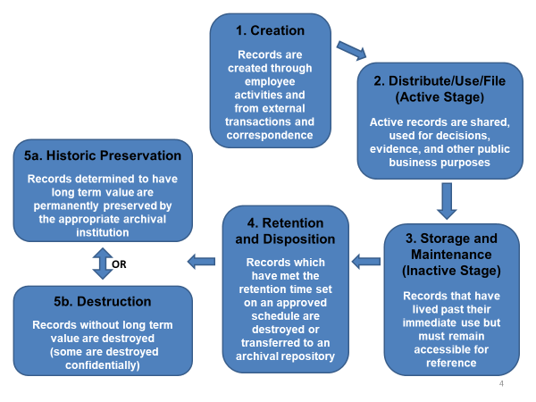
Life Cycle of a Record

Slide 5
Why Public Records Management?
Comply with applicable legal requirements
Promotes transparency in government
Documents governmental activities
Fulfill obligations efficiently to the public
Minimizes legal risk
Facilitates decision making
Retrieve information faster
Promotes best practices in state agency record keeping

Slide 6
What Are Your Public Records Responsibilities?
Recognize and manage public records created as part of your job duties
Protect and save public records you create and use
File paper and electronic documents so they can be readily accessed (use agency file plan if applicable)
Safeguard confidential and sensitive information
Dispose of information that is not defined as a public record
Retain public records for the appropriate length of time
Dispose of public records in accordance with an approved Retention Disposition Authorization (RDA)
Know where to go for help

Slide 7
What is a Public Record?
Recorded information, in any format (including paper, electronic, audio/visual, calendars, maps) created or received by a state employee and/or agency in the transaction of business
Information content determines what is a record and not the format in which the information is generated. Records may be textual, pictorial, paper, electronic, audio, video, etc.

Slide 8
What is a Public Record?
Created in the course of public business
Examples: correspondence and memos (paper and electronic), agreements, studies, reports
Received for action
Examples: Information or public records requests, tracked correspondence
Mandated by statute or regulation
Examples: statutorily required programs, administrative records, dockets, equal rights complaints

Slide 9
Where Might Public Records Occur?
Information content determines what constitutes a public record and not the format in which the information is generated.
Email and voicemail
Text, instant messages and chats
Social media and Websites
Audio, video and online meeting
platform recordings
Calendars
Documents
Spreadsheets and databases
Personal devices if used for government unit business
Maps and blueprints

Slide 10
What Qualities do Public Records Have?
Document government unit activities
Examples: calendars, meeting minutes, project reports
Support financial obligations or legal claims
Examples: grants, contracts, litigation case files or audits
Communicate agency requirements
Examples: guidance documents, policies, procedures

Slide 11
What Public Records Might You Have?
Correspondence related to public business
Program-related documentation
Team, project, committee, or workgroup documentation
Activity and project reports
Training materials you have presented
Work/information requests
Operating procedures
Calendars and schedules

Slide 12
What Is Not a Public Record under Wis. Stat § 16.61(2)(b) for retention purposes?
Reference materials and stock copies
Examples: vendor catalogs, blank forms
Copies
Examples: copies of records (paper or electronic) for convenience or reference purposes only
Draft or working papers
Examples: draft documents without substantive comments, rough notes for personal use (It should be noted that some drafts are needed to support a decision trail or are otherwise required by an RDA)
Unsolicited email (internal or external)
Examples: reminders received by all staff, listserv

Slide 13
How Do I Manage Public Records?
Policies
Learn your government unit’s records management policies
Know which records disposition authorization (RDA) relates to your program records
Filing
File public records to allow for easy access over time
File records in accordance with your government unit’s approved filing system to simplify retrieval

Slide 14
How Do I Manage Public Records?
Continued …
People
Contact your Records Officer or designated
Records Custodian with questions
Disposition
Dispose of records according to the
approved RDA
Note: Your government unit may only legally dispose of records as approved by an authorized records schedule

Slide 15
What Is A Retention / Disposition Schedule?
Records Disposition Authorizations (RDAs):
Mandate how long public records are kept (retention)
Group and describe related public records
Mandate what happens to public records at the end of that time period (disposition)
Are promulgated as policy via a General Records Schedule (GRS) or agency specific RDA

Slide 16
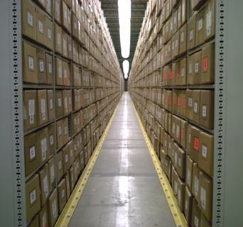
Summary
You will create and receive public records
You are responsible for managing them
This is accomplished through GRSs and RDAs
Proper public records management will improve your effectiveness and efficiency
There are resources to assist you
Records Coordinators
Records Custodians
Records Officer
Legal counsel

