Slide 1
Introduction to Public Records for Wisconsin Public Records Board Members

Slide 2
Where Are Public Records Defined?
Wis. Stat. § 16.61(2)(b) defines “public records” for the purposes of records retention and disposition
Wis. Stat. § 19.32(2) defines “records” for purposes of the records access and disclosure provisions of Wis. Stat. §§ 19.31-19.39 (known as the public records law or the open records law)

Slide 3
Why Public Records Management?
Compliance with applicable legal requirements
Promotes transparency in government
Documents governmental activities
Minimizes litigation risk
Facilitates decision making
Retrieve information faster
Promotes best practices in state agency record keeping

Slide 4
PRB Organization and Functions
Established as Public Records Board in 1967
Oversees several committees:
Records Management Committee
Policy and Governance Committee
Operations and Training Advisory Committee
Develops rules and guidelines that promote responsible records management practices
Meets quarterly to address records management issues
Approves records disposition authorizations (RDAs) based on the recommendation of the Records Management Committee

Slide 5
Makeup of the PRB
The PRB is attached to the Department of Administration (DOA) and consists of:
Director of the Historical Society (or his/her designee)
Attorney general (or his/her designee)
State auditor (or his/her designee)
Director of the legislative council staff (or his/her designee)
Governor’s designees (4)
Small Business Community Local Government
Other Member At Large Member

Slide 6
https://publicrecordsboard.wi.gov/

Slide 7
What Responsibilities Do PRB Members Have?
Define and approve public records policy standards
Develop and approve records disposition authorizations (RDAs) for all government units
Create and promulgate records management rules and directives intended to protect and preserve public records
Review and advise on electronic public records rules and standards

Slide 8
What Responsibilities Do PRB Members Have?
Continued …
Establish minimum retention periods for public records of all government units
Recommend qualitative standards for storage of public records in electronic formats
Create a registry of public record series which contain Personally identifiable Information (PII)
Serve on Committees (see following slides)

Slide 9
What Responsibilities Do PRB Members Have?
Continued …
Records Management Committee (RMC)
The Committee meets before the Public Records Board’s quarterly meetings to review agency Records Disposition Authorization (RDA) submissions and general schedules. The committee’s review provides consistency among agencies in their approach to retention and disposition of records, promotes use of general schedules whenever possible and flags overriding questions that should be addressed by the Board. The committee meetings provide an opportunity for committee members to discuss specific RDAs with the submitting entity.

Slide 10
What Responsibilities Do PRB Members Have?
Continued …
Policy and Governance Committee
Committee meets as necessary to develop policy proposals for the Board’s consideration, assists the chair in setting priorities and directing resources and promotes collaboration and communication between the Board and its partners. They look at specific issues, procedures or policies and makes recommendations to the Board for changes that further promote the statutory mission of the Board.

Slide 11
What Responsibilities Do PRB Members Have?
Continued …
Operations and Training Advisory Committee (OTAC)
Committee supports the day-to-day duties and responsibilities of records officers in state and local governments through development of special projects, guidelines, regular training and addressing challenges related to emerging technology. The Committee is charged with organizing professional records management training which could include a statewide conference or webinars.

Slide 12
Key Wisconsin State Statutes
§ 15.105(4) PRB makeup § 16.61 Powers and duties of the PRB § 16.61(2)(b) Definition of a public record and what is not a public record for record retention purposes § 16.61(3)(e) Ability to establish minimum time periods for any local government § 16.61(3)(u) PRB PII registry requirement § 16.61(4) Approval for disposition of records § 16.62(1)(b) Operation of a records center § 19.21(2) Transition of records on administration change § 19.21(4)(a) 60 day notice to WHS § 19.21(4)(b) 7 year statute for municipal records | § 19.21(5)(c) 7 year statute for county records § 19.21(7) Tapes of meeting minutes retained for 90 days, if purpose of tape was to make minutes § 19.31-19.39 Public (open) records law § 19.32(2) Definition of a record – for public records law purposes § 19.62(5) PII definition § 19.82(1) Definition of governmental body § 19.82(2) Definition of a meeting § 59.20(3)(a) County offices keep open books § 893.82(3) 120 day retention justification for video/monitoring recordings

Slide 13
Key Items of Note
Wis. Stats. §16.61 includes:
Definition of a public record for purpose of records retention obligations
Public records responsibilities
Records management requirements
Admin 12 includes:
Electronic public records management – standards and requirements

Slide 14
Key Items of Note
Continued …
Wis. Stats §19.32(2) includes:
Definition of a “record” for the purpose of access and disclosure, pursuant to the Wisconsin public records law (Wis. Stat. § §19.31-19.39)
Wis. Stat. §19.32(2) is used for responding to public records requests.

Slide 15
What is Records Management?
The practice of maintaining records throughout their lifecycle
Records management programs manage organizational information to ensure it is useable, cost-effective, timely, accurate, complete and easily accessible
Disposing of unneeded and outdated content after the appropriate retention period allows for easier retrieval of records

Slide 16
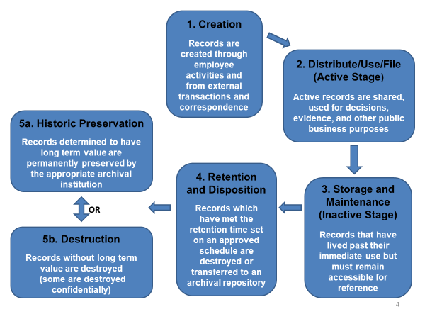
Life Cycle of a Record

Slide 17
What is a Public Record?
Recorded information, in any format (including paper, electronic, audio/visual, calendars, maps) created or received by a state employee and/or agency in the transaction of public business
Information content determines what is a record and not the format in which the information is generated. Records may be textual, pictorial, paper, electronic, audio, video, etc.

Slide 18
What is a Public Record?
Created in the course of public business
Examples: correspondence and memos (paper and electronic), agreements, studies, reports
Received for action
Examples: Information or public records requests, tracked correspondence
Mandated by statute or regulation
Examples: statutorily required programs, administrative records, dockets, equal rights complaints

Slide 19
What Qualities do Public Records Have?
Document government unit activities
Examples: calendars, meeting minutes, project reports
Support financial obligations or legal claims
Examples: grants, contracts, litigation case files or audits
Communicate agency requirements
Examples: guidance documents, policies, procedures

Slide 20
Where Might Public Records Occur?
Information content determines what constitutes a public record and not the format in which the information is generated.
Email and voicemail
Text, instant messages and chats
Social media and Websites
Audio, video and online meeting
platform recordings
Calendars
Documents
Spreadsheets and databases
Personal devices if used for government unit business
Maps and blueprints

Slide 21
What Public Records Might You Have?
Records pertaining to Boards, Councils, and Committees
Materials for internal and external meetings
Records that document the development of policies and programs
Reports to the Secretary, Governor or other officials
Business related memos or correspondence
Information related to budget development and fiscal planning
Materials that document decision making
Calendars, schedules and logs of daily activities

Slide 22
What Is Not a Public Record under Wis. Stat. § 16.61(2)(b) for retention purposes?
Reference materials and stock copies
Examples: vendor catalogs, blank forms
Copies
Examples: copies of records (paper or electronic) for convenience or reference purposes only
Draft or working papers
Examples: draft documents without substantive comments, rough notes for personal use (It should be noted that some drafts are needed to support a decision trail or are otherwise required by an RDA)
Unsolicited email (internal or external)
Examples: reminders received by all staff, listserv

Slide 23
A Note About Publications…
Publications are not considered public records per state statutes and therefore are not scheduled
However, they are collected and preserved through the Wisconsin Document Depository Program. The program, managed by the Department of Public Instruction, collects, catalogs, and distributes paper and electronic government publications

Slide 24
How Do Government Units Manage Public Records?
Policies
Government units create (and the PRB approves) RDAs
Committees are charged by the PRB to develop General Records Schedules (GRSs) which address records common to governmental units
Records Designations
Wis. Stat. §15.04(j): Specifies each agency will appoint a Records Officer who coordinates records management
Wis. Stat. § 19.32(1): Defines authority as it pertains to the custody of records
Wis. Stat. § 19.33: Delineates who is the legal custodian of a record

Slide 25
How Do Government Units Manage Public Records?
Continued …
State Records Center
The State Records Center (SRC) stores public records for agencies and facilitates the disposal of public records per approved schedule(s)
Wisconsin Historical Society
The Wisconsin Historical Society (WHS), as the State Archives, is charged with the permanent preservation of select government records. WHS public records staff is available to consult with agencies on records issues

Slide 26
What Is A Retention / Disposition Schedule?
Records Disposition Authorizations (RDAs):
Mandate how long public records are kept (retention)
Group and describe related public records
Mandate what happens to public records at the end of that time period (disposition)
Are promulgated as policy via a General Records Schedule (GRS) or agency specific RDA

Slide 27
Records Disposition Authorizations
Valid for ten years
Updated, amended and revised as needed
Changes are approved by the Public Records Board
RDAs may be extended beyond their sunset day for an additional 18 months in accordance with PRB Extension policy (approved May 2010)

Slide 28
PRB General Records Schedules
Administrative Related Records
Budget and Related Records
County Records
Facilities Management and Related Records
Fiscal and Accounting Related Records
Fleet and Aircraft Management Related Records
Human Resources and Related Records
Information Technology and Related Records
Municipal Records
Payroll and Related Records
Public Library and Public Library Systems
Public School District Records
Purchasing and Procurement and Related Records
Risk Management and Related Records

Slide 29
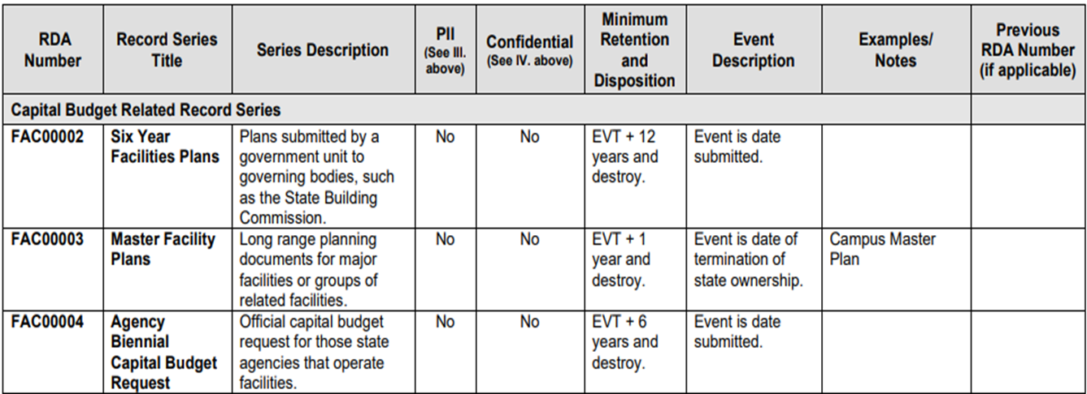
Example: General Records Schedule
Facilities Management and Related Records Schedule

Slide 30
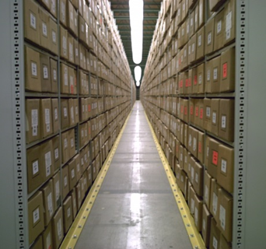
Summary
You represent public records retention law
You are the face of Wisconsin records management
Government units depend on you for public record guidelines
Government units cannot
complete their public records
responsibilities without your
guidance

