Slide 1
Managers & Supervisors
Introduction to Records Management

Slide 2
Where Are Public Records Defined?
Wis. Stat. § 16.61(2)(b) defines “public records” for the purposes of records retention and disposition
Wis. Stat. § 19.32(2) defines “records” for purposes of the records access and disclosure provisions of Wis. Stat. §§ 19.31-19.39 (known as the public records law or the open records law)

Slide 3
What is Records Management?
The practice of maintaining records throughout their lifecycle
Records management programs manage organizational information to ensure it is useable, cost-effective, timely, accurate, complete and easily accessible
Disposing of unneeded and outdated content after the appropriate retention period allows for easier retrieval of records

Slide 4
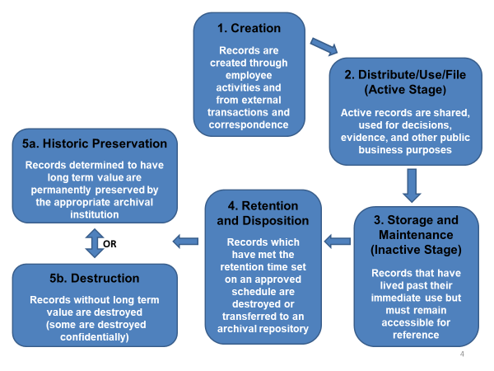
Life Cycle of a Record

Slide 5
Why Public Records Management?
Ensure statutory and regulatory compliance
Preserve the rights of citizens to have access to public records
Support better decision making
Safeguard vital information
Preserve organizational memory
Reduce operating costs
Minimize legal risks

Slide 6
What Are Your Public Records Responsibilities?
Ensure staff has basic knowledge about records management
Document program area business activities and decisions
Know program area business records and ensure they managed according to an approved records disposition authorization (RDA)
Ensure public records are disposed in accordance with an approved RDA

Slide 7
What Are Your Public Records Responsibilities?
Continued …
Safeguard confidential, sensitive, and personally identifiable information (PII) such as personnel records
Communicate records roles and responsibilities to your employees
Ensure records are filed for safe storage and efficient retrieval
Identify and transfer records prior to employee departures
Have a method to identify legal holds that halt records disposition

Slide 8
What Are Your Staff’s Public Records Responsibilities?
Recognize and manage public records created as part of their job duties
Protect and save public records they create and use
File paper and electronic documents so they can be readily accessed (use agency file plan if applicable)
Safeguard confidential and sensitive information
Dispose of information that is not defined as a public record
Retain public records for the appropriate length of time
Dispose of public records in accordance with an approved Retention Disposition Authorization (RDA)
Know where to go for help

Slide 9
What is a Public Record?
Recorded information, in any format (including paper, electronic, audio/visual, calendars, maps) created or received by a state employee and/or agency in the transaction of business
Information content determines what is a record and not the format in which the information is generated. Records may be textual, pictorial, paper, electronic, audio, video, etc.

Slide 10
What is a Public Record?
Created in the course of public business
Examples: correspondence and memos (paper and electronic), agreements, studies, reports
Received for action
Examples: Information or public records requests, tracked correspondence
Mandated by statute or regulation
Examples: statutorily required programs, administrative records, dockets, equal rights complaints

Slide 11
Where Might Public Records Occur?
Information content determines what constitutes a public record and not the format in which the information is generated.
Email and voicemail
Text, instant messages and chats
Social media and Websites
Audio, video and online meeting
platform recordings
Calendars
Documents
Spreadsheets and databases
Personal devices if used for government unit business
Maps and blueprints

Slide 12
What Public Records Might You Have?
Records pertaining to Boards, Councils, and Committees
Policy and procedure documentation
Program area activity, production and employee reports and files
Project reports and files
Business related memos or correspondence
Open records requests and responses
Reports to senior management
Calendars, schedules and logs of daily activities

Slide 13
What Is Not a Public Record under Wis. Stat. § 16.61(2)(b) for retention purposes?
Reference materials and stock copies
Examples: vendor catalogs, blank forms
Copies
Examples: copies of records (paper or electronic) for convenience or reference purposes only
Draft or working papers
Examples: draft documents without substantive comments, rough notes for personal use (It should be noted that some drafts are needed to support a decision trail or are otherwise required by an RDA)
Unsolicited email (internal or external)
Examples: reminders received by all staff, listserv

Slide 14
How Do I Manage Public Records?
Policies
Learn your government unit’s records management policies
Know which records disposition authorization (RDA) relates to your program records
Filing
File public records to allow for easy access over time
File records in accordance with your government unit’s approved filing system to simplify retrieval

Slide 15
How Do I Manage Public Records?
Continued …
People
Contact your Records Officer or designated
Records Custodian with questions
Disposition
Dispose of records according to the
approved RDA
Note: Your government unit may only legally dispose of records as approved by an authorized records schedule

Slide 16
What Is A Retention / Disposition Schedule?
Records Disposition Authorizations (RDAs):
Mandate how long public records are kept (retention)
Group and describe related public records
Mandate what happens to public records at the end of that time period (disposition)
Are promulgated as policy via a General Records Schedule (GRS) or agency specific RDA

Slide 17
Records Disposition Authorizations
Valid for ten years
Updated, amended and revised as needed
Changes are approved by the Public Records Board
RDAs may be extended beyond their sunset day for an additional 18 months in accordance with PRB Extension policy (approved May 2010)

Slide 18
PRB General Records Schedules
Administrative Related Records
Budget and Related Records
County Records
Facilities Management and Related Records
Fiscal and Accounting Related Records
Fleet and Aircraft Management Related Records
Human Resources and Related Records
Information Technology and Related Records
Municipal Records
Payroll and Related Records
Public Library and Public Library Systems
Public School District Records
Purchasing and Procurement and Related Records
Risk Management and Related Records

Slide 19
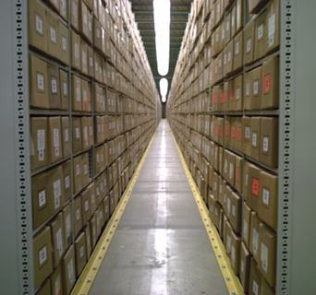
Summary
Protect and save the public records your unit creates and uses
Safeguard confidential and sensitive information appropriately
Know that public records consist of all forms of media
Be familiar with the RDAs which relate to your programs
Do not dispose of any public record unless you are following an RDA
File all public records according to a consistent filing plan
Learn to manage public records as part of your job duties
Ask records staff for assistance
Records Officer Records Coordinators
Legal counsel Records Custodians

